Slide 1




Sensitive Responsive Workplaces
Intelligent buildings for wellbeing
Lenia Margariti
PhD student - Open Lab, Newcastle University
Notes:
Quantified?
Intelligent?
Smart?
Should I frame it as smart buildings, or workplaces, or workspaces?
Should I discuss about physical or also digital dimensions? ---workplace is the place, workspace is the digital dimension of work (workstation)

Slide 2
Technology is shaping the workplace.
Intelligent buildings for wellbeing
Technology changes the places and spaces that we work, and the ways we collaborate.
Connected workers.
Remote (home) work.
Distance matters less as work becomes more technology mediated.
Blending the office space with the domestic sphere.
Environmental monitoring.
Adaptive space use.
Office buildings that monitor environmental data to manage indoor climate.
Using IoT to efficiently manage work areas and space-use.
Notes:
Blending the office space with the domestic sphere.

Slide 3
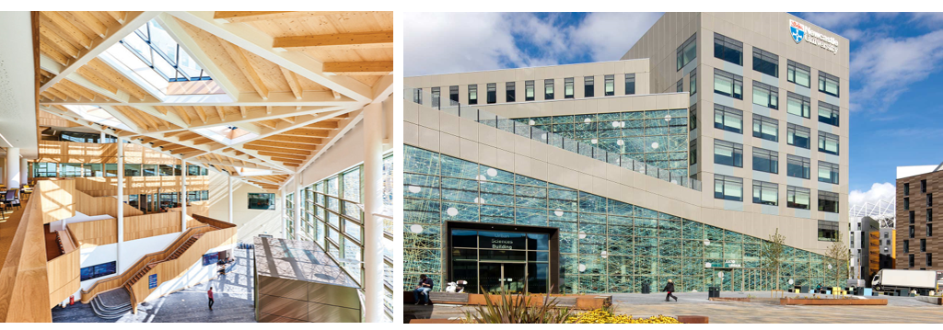
Workplaces as data-rich ecosystems.
Intelligent buildings for wellbeing
Urban Sciences Building, Newcastle Upon Tyne, UK
Notes:
https://3d.usb.urbanobservatory.ac.uk/

Slide 4
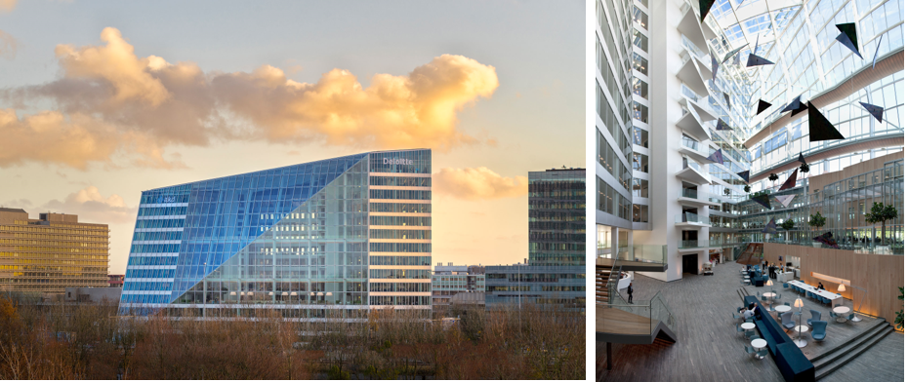
Workplaces as data-rich ecosystems.
Intelligent buildings for wellbeing
The Edge, Amsterdam, NL
Notes:
https://3d.usb.urbanobservatory.ac.uk/

Slide 5
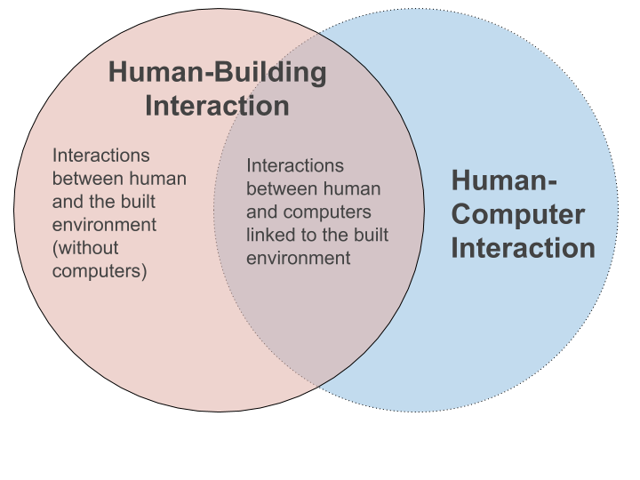
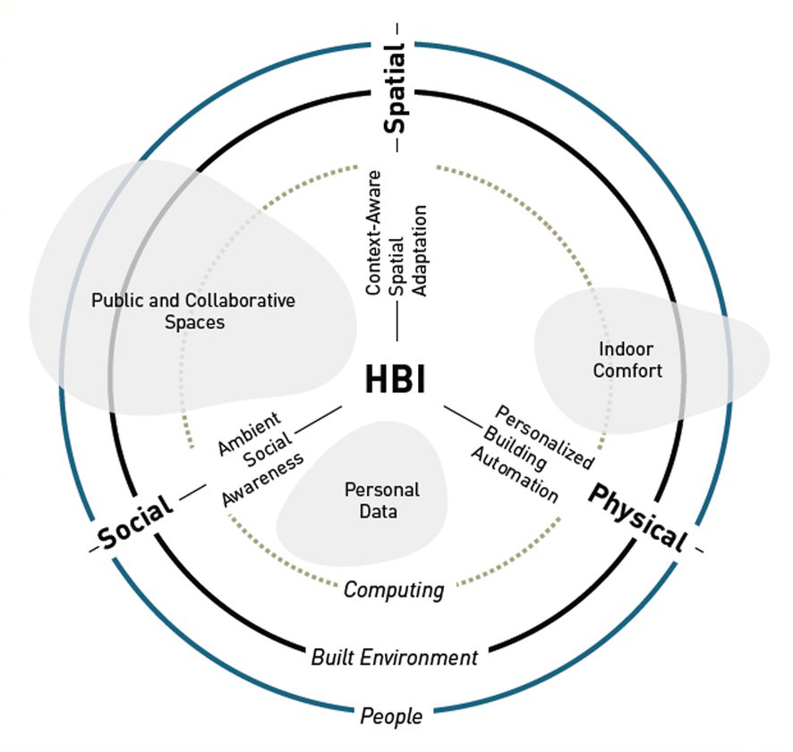
Intelligent buildings for wellbeing
Addressing users in intelligent buildings.
Users and their wellbeing needs remain under-addressed in the context of intelligent buildings.
Human Building Interaction (HBI) research agenda seeks to address these gaps.
Notes:
https://youtu.be/zwarPoJgpJ0
Within this problem space and address some of these limitations of smart environments, the interdisciplinary HBI field has been evolved.
Studying How users interact with smart environments and what are the potentials/implications in that space
There are three major forces driving the current evolution toward human-building interaction: 1) recent advancements in sensing and communication technologies that enable the integration of computerized elements into physical infrastructures (e.g., NarrowBand IoT), 2) developments within architectural practice that include reactive, interactive, and self-modifying architectural elements, and 3) ecological and sustainability concerns that call for lasting, human-centered environments.
https://interactions.acm.org/archive/view/july-august-2019/human-building-interaction
https://medium.com/@jayzhaonyc/what-is-human-building-interaction-hbi-a6839a88f121
The research agenda of human points to some directions for future development of human - centric smart environments, for instance
Buildings as interfaces / technologies for negotiation and collaboration between different occupant groups (Reference Human Building Collaboration);
As technologies to enhance social awareness and social interaction; advance personalized building control, and context-aware adaptation; but not limited to these.
data feedback loops in these environments and temporal aspects of interaction as some of the points of interests.
How users interact with smart environments and what are the potentials/implications in their behaviour in that space

Slide 6
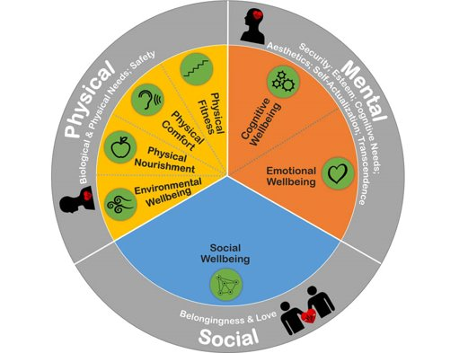
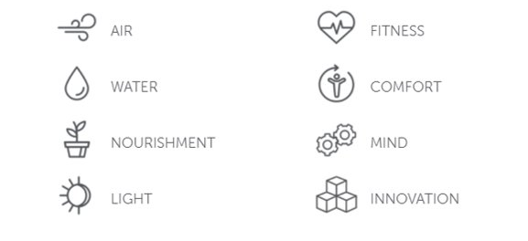
Intelligent buildings for wellbeing
Addressing wellbeing
in the workplaces.
A framework for modelling and assessing wellbeing in the buildings for work.
PROWELL
Notes:
There are many dimensions to workplace wellbeing, and many approaches to assess it. One of the most comprehensive approaches for KPIs in workplace wellbeing comes from PROWELL -see
https://www.innovativeworkplaceinstitute.org/workplace-wellbeing-prowell.php
https://www.ucl.ac.uk/bartlett/environmental-design/workplace-health-wellbeing-linking-environment-employee-health-wellbeing-workplaces
Whereby workplace wellbeing is addressed as a set of physical, mental and social aspects.
This model refers to collocated workplaces and not to remote connected workplaces, and therefore has limitations.
For the purpose of our research and given that we re-frame aspects of this model to embrace challenges of the remote workplace wellbeing that are not addressed by the current model.
https://workinmind.org/
https://legacy.wellcertified.com/en
https://workinmind.org/2020/06/03/workplace-ergonomics-how-to-create-a-healthy-home-office/

Slide 7
Workplace wellbeing design futures.
Intelligent buildings for wellbeing
Passive & Eco
Aware & Happy
Connected / Disconnected
Bio-design; passive & slow adaptations for climate control based on environmental data;
Workplaces that enhance self-awareness and social awareness through data interactions.
Surfacing data for wellbeing; engage the occupants to interact with the data.
Adaptive spaces to accommodate work – life transitions in hybrid and remote work;
Workplaces that enhance climate awareness (eco-feedback);
Enhancing the physical and the tangible in the workplace.
Socially connected workplaces;
Privacy – friendly workplaces.
Notes:
https://interactions.acm.org/archive/view/may-june-2020/technologies-for-healthy-work
There are these shifts in policy level, but these are conditions yet to be met.

Slide 8
Intelligent workplaces for wellbeing
Designing data-ecosystems for a hybrid workplace wellbeing.
Adaptive comfort.
Socially connected workplaces
Enhancing comfort to any wok-place; adapt to different wellbeing needs.
Enhancing social and emotional awareness in remote through ambient interactions.
Environmentally aware office.
On / Off workplace.
Environmental monitoring and calm eco-feedback to surface latent aspects.
Ambient interactions for transitioning between online and offline work, and between work and domestic life.
Notes:
Co-designing connected data ecosystems for workplace wellbeing.

Slide 9



Thank you
Lenia Margariti
PhD student - Open Lab, Newcastle University

